Slide 1


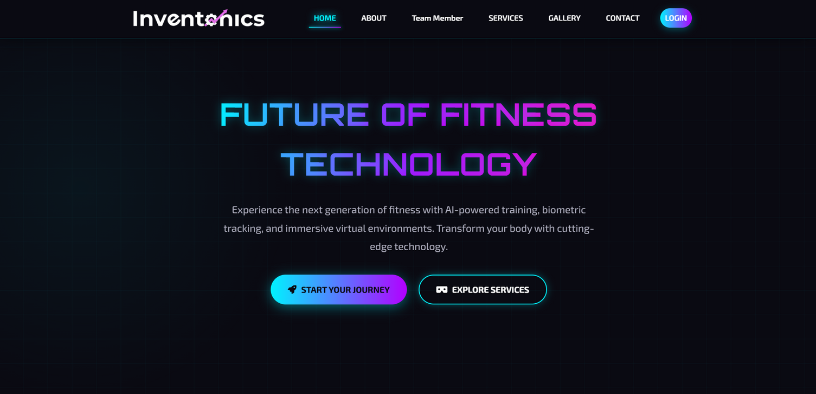
#inventonics
Inventonics Digital
Sofware Company
Prepared by
Abdul Rafay
(2025F-BSE-241)
Mohsin
(2025F-BSE-226)

Slide 2
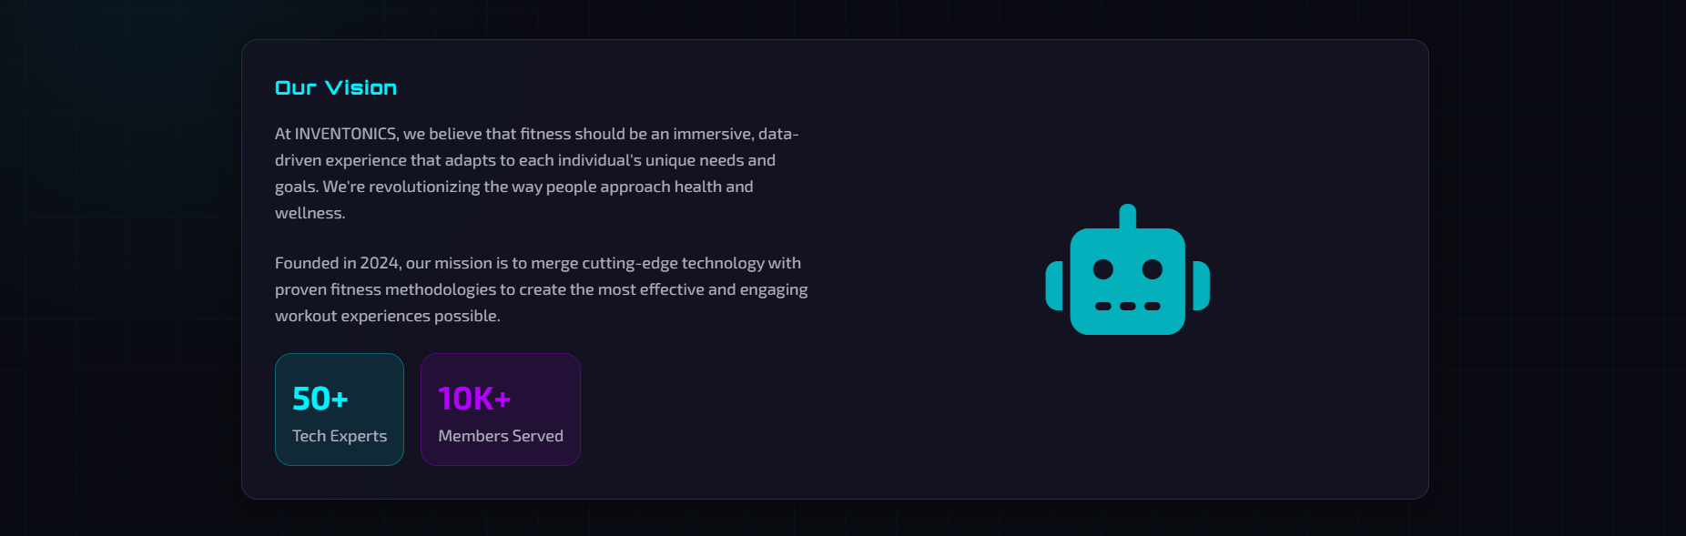
Website Objectives
Key Features
Showcase company services globally
Responsive neon-themed design.
Project Purpose
Professional team presentation
User authentication system
Client inquiry management
Service portfolio display

Slide 3
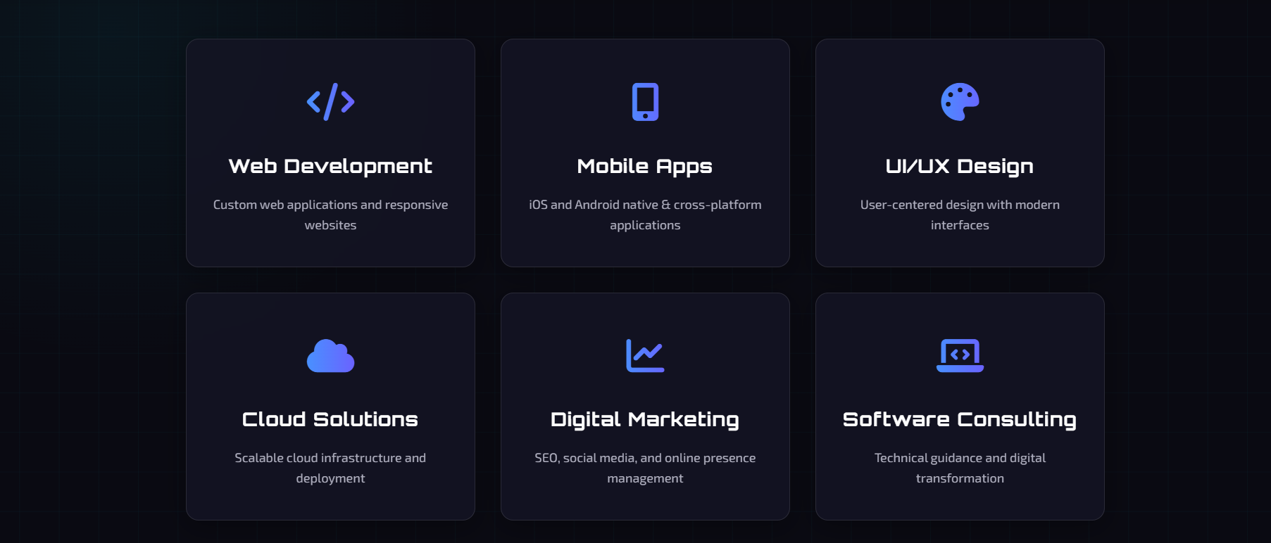
Our Services
Comprehensive fitness solutions powered by cutting-edge technology

Slide 4
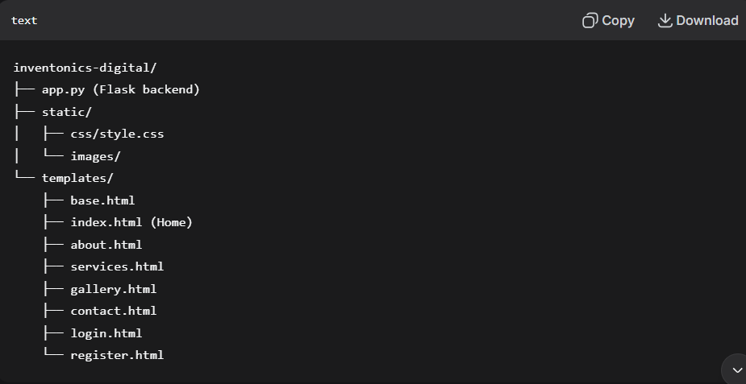
Project Structure

Slide 5
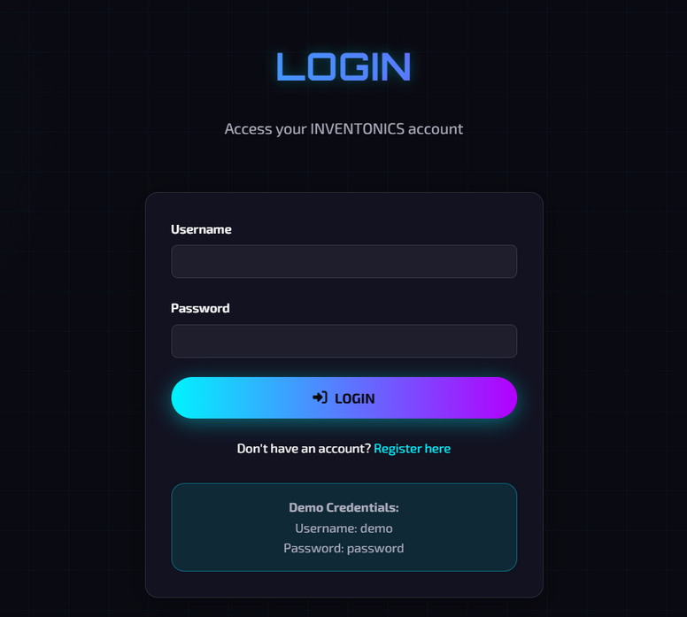

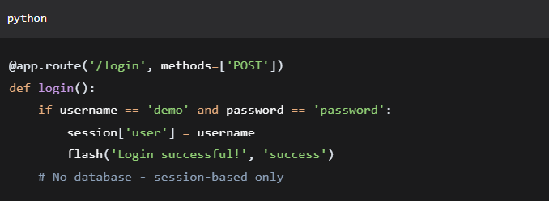
Authentication Workflow
Simulated Login System
User Registration → Form Validation → Flash Message
User Login → Session Creation → Page Access
Logout → Session Clear → Redirect Home

Slide 6

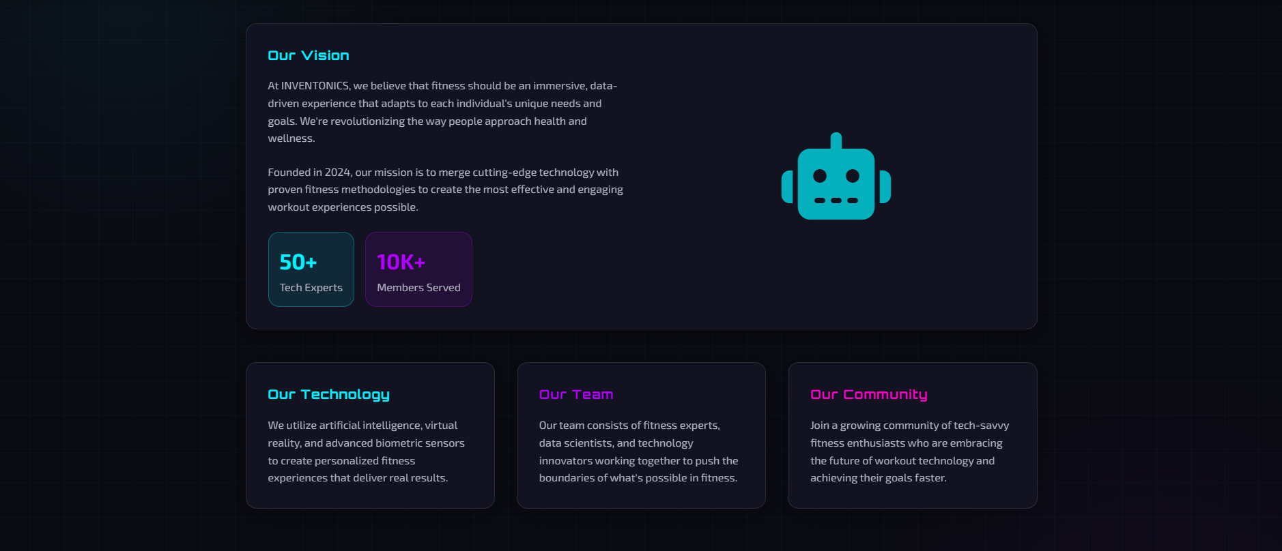

Frontend Design
Modern Tech Theme:
Cyber grid background
Neon color scheme (#00f3ff, #b300ff)
Glass morphism effects
Smooth hover animations
Fully responsive design
Mobile-first approach

Slide 7
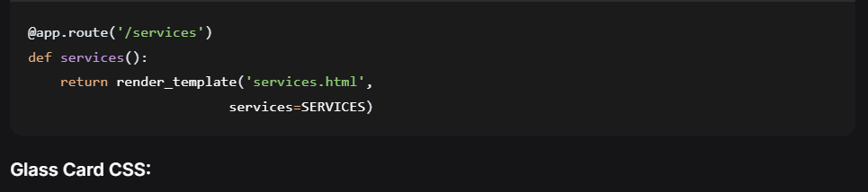
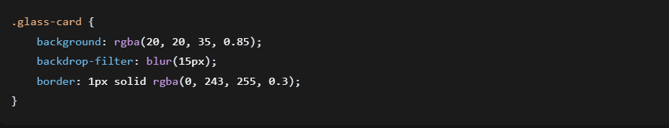
Key Code Snippet
Flask Route Example:
Glass Card CSS:

Slide 8


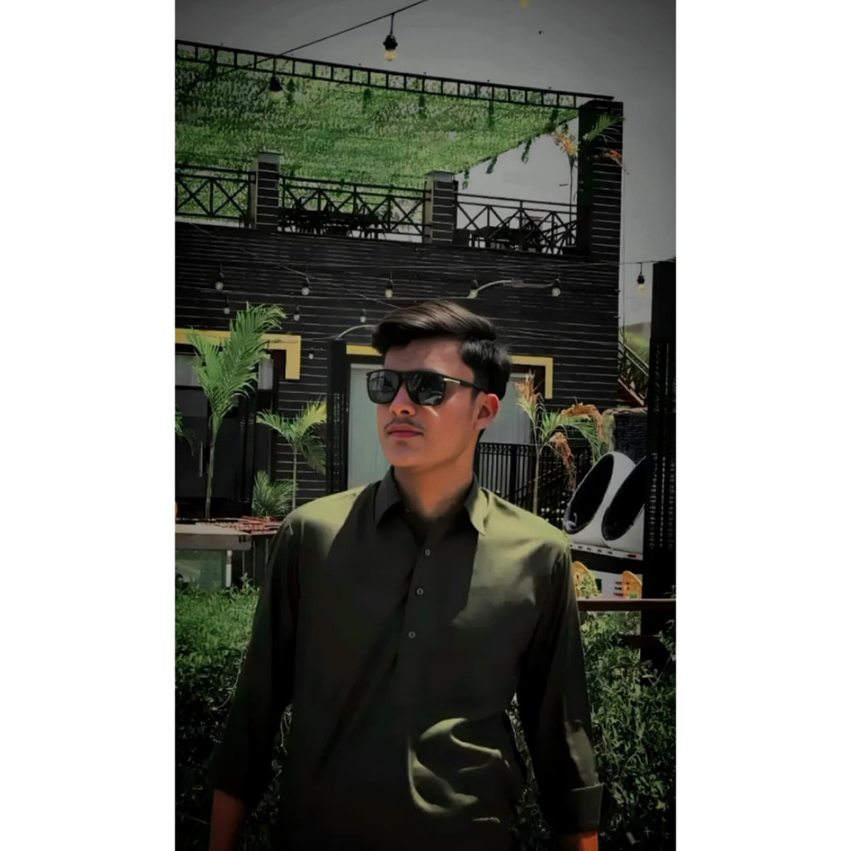
Our Group/Team
Abdul Rafay
Web Application Developer - Founder of Inventonics Digital
MOhsin
Beginner

Slide 9
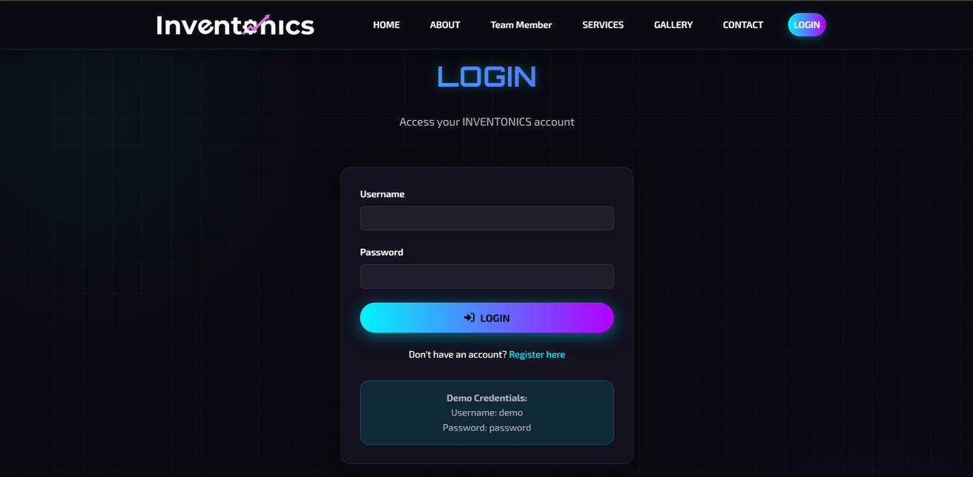
Technical Highlights
#inventonics
Backend:
Flask web framework
Session management
Form handling
Template rendering
Frontend:
Modern CSS3 features
Responsive design
Interactive elements
Professional UI/UX

Slide 10
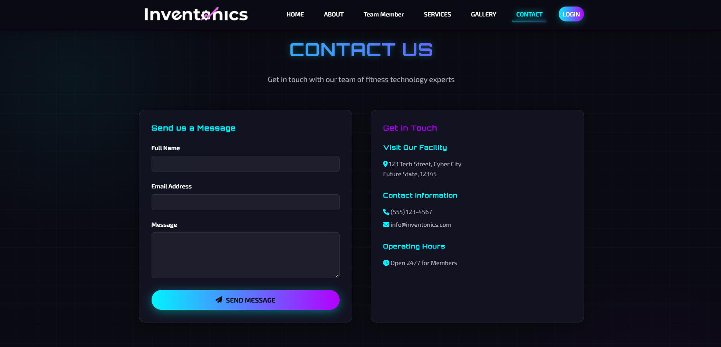
Live Demo:
Future Enhancements:
Demo & Conclusion
Website navigation
User authentication flow
Responsive testing
Form submissions
Database integration
Payment gateway
Admin dashboard
Multi-language support

